Slide 1

An Equilibrium Business-Cycle Model

Slide 2
Cyclical Behavior of Real GDP—Recessions and Booms
Real GDP=
trend real GDP + cyclical part of real GDP
Cyclical part of real GDP=
real GDP− trend real GDP
Cyclical part of real GDP is
  Coming from the business cycle（经济周期）：short-term economic fluctuations.

Slide 3
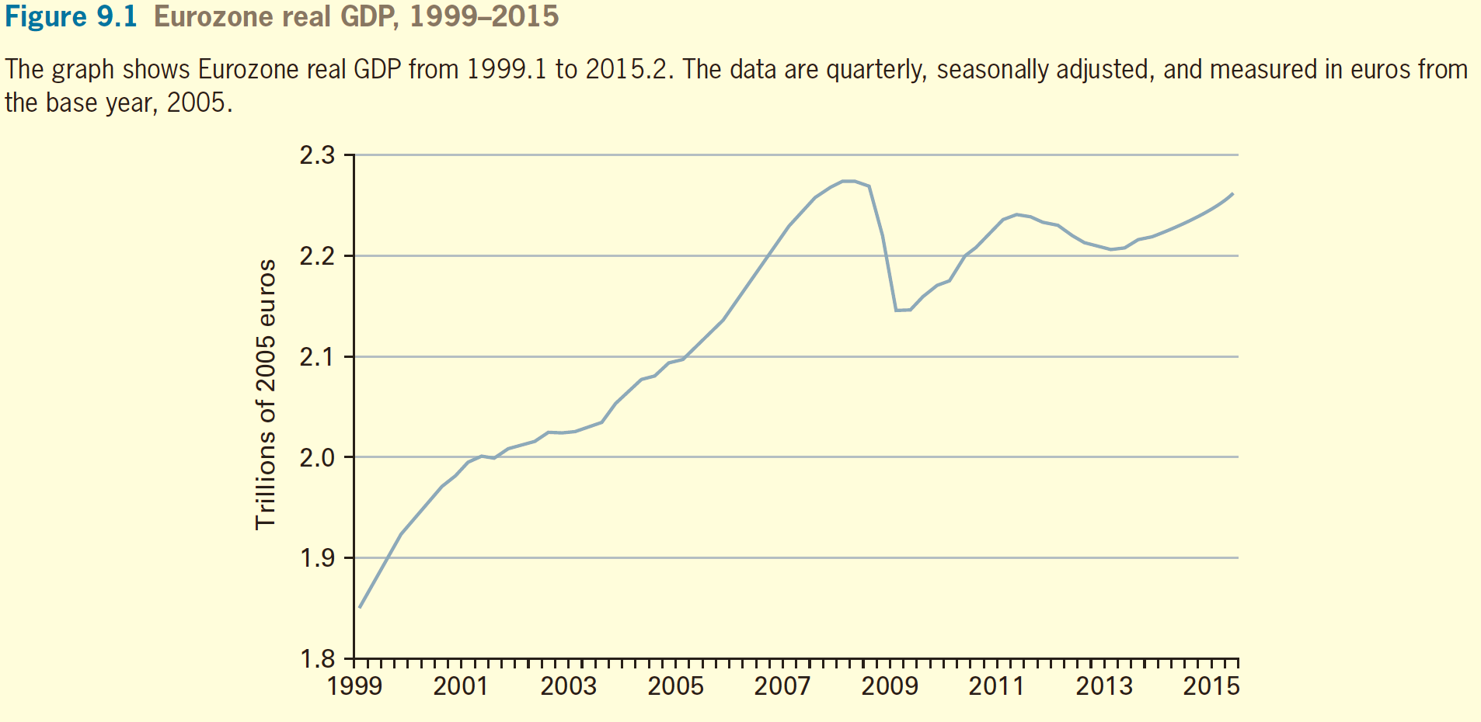
Cyclical Behavior of Real GDP—Recessions and Booms

Slide 4
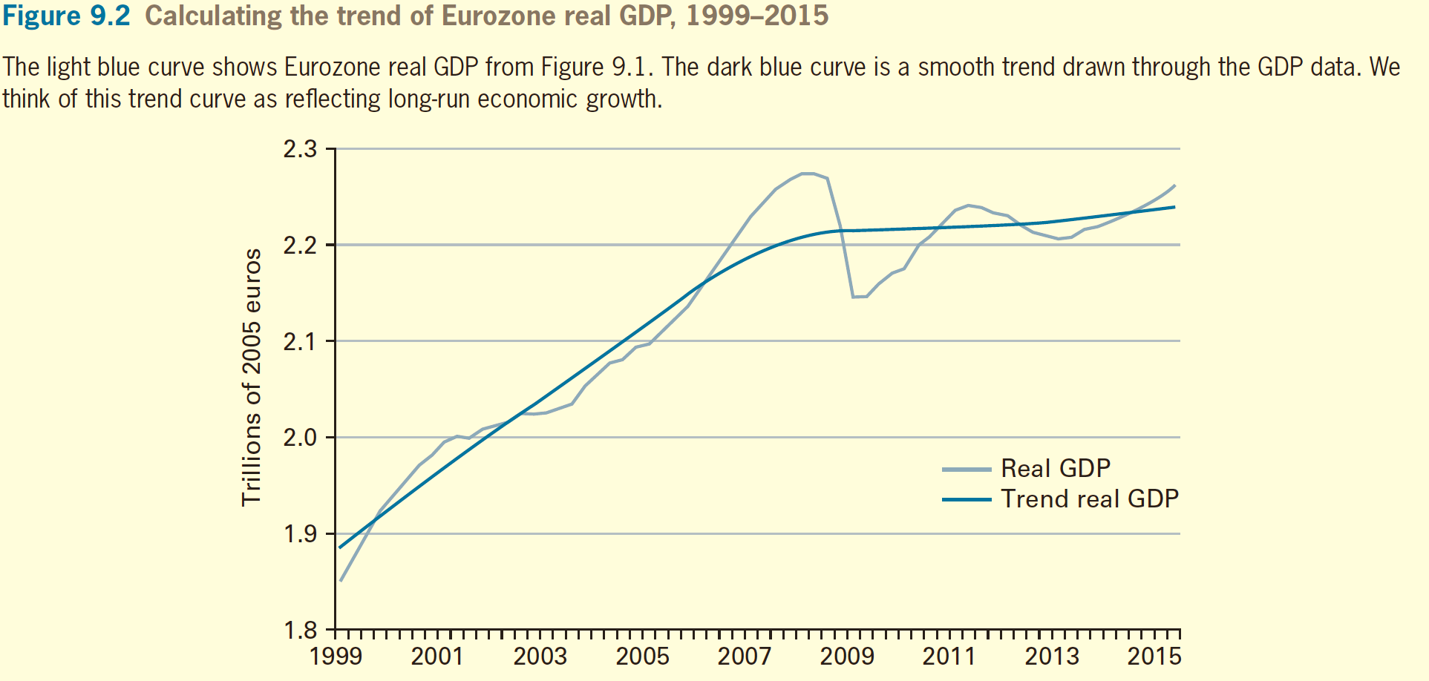
Cyclical Behavior of Real GDP—Recessions and Booms

Slide 5
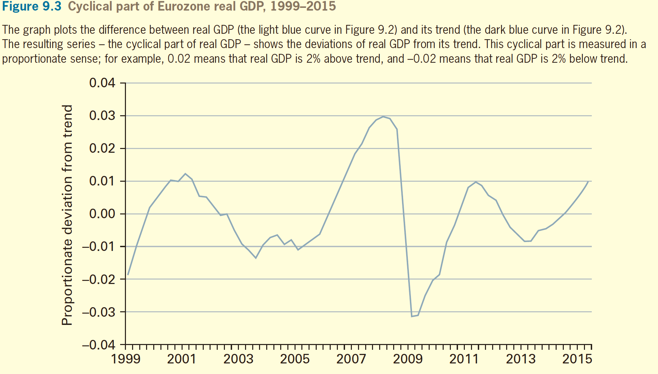
Cyclical Behavior of Real GDP—Recessions and Booms

Slide 6
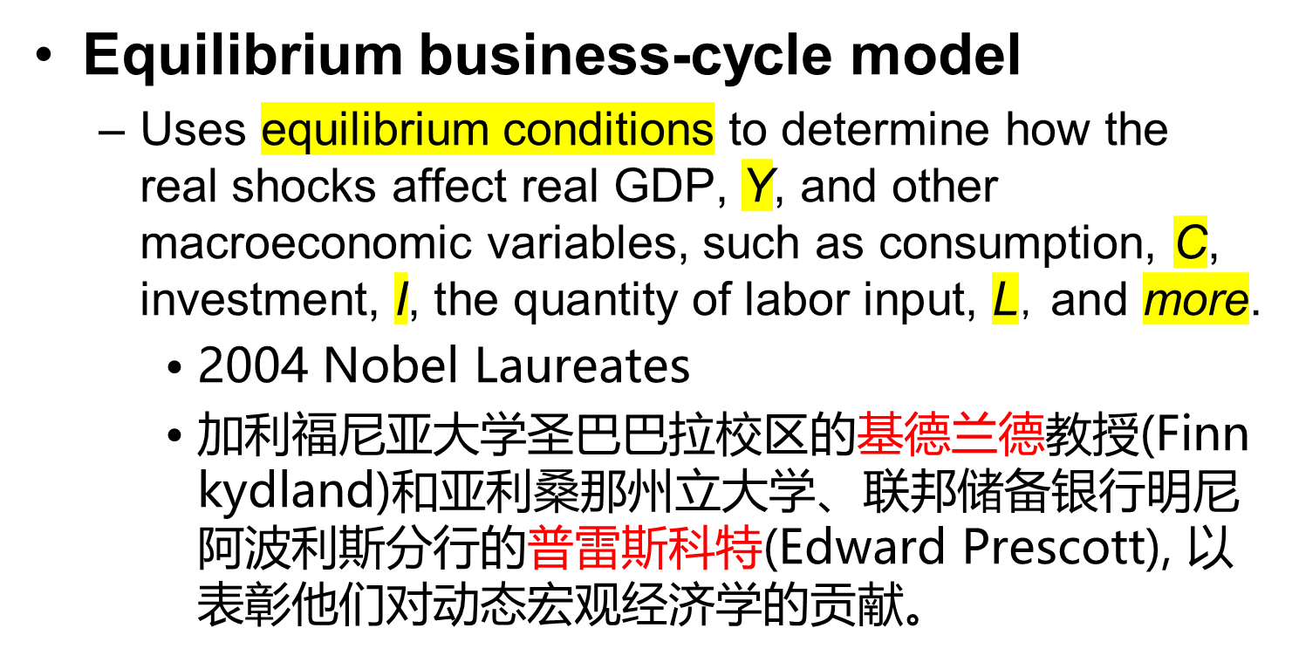
An Equilibrium
Business-Cycle Model

Slide 7
An Equilibrium
Business-Cycle Model
Equilibrium business-cycle model
    他们是新古典宏观经济学实际经济周期学派的代表人物，提出实际经济周期模型。
    Real shock: 实际冲击，即生产率或者工人工作意愿的冲击。
    实际经济周期模型（real business cycle model）假设所有的工资和价格都是完全灵活的，实际冲击导致潜在产出或长期总供给的波动，在工资和价格完全灵活的情况下，短期总供给和长期总供给曲线相同，因此在关于实际经济周期的总供给和总需求分析中，只有一条长期总供给曲线LRAS。

Slide 8
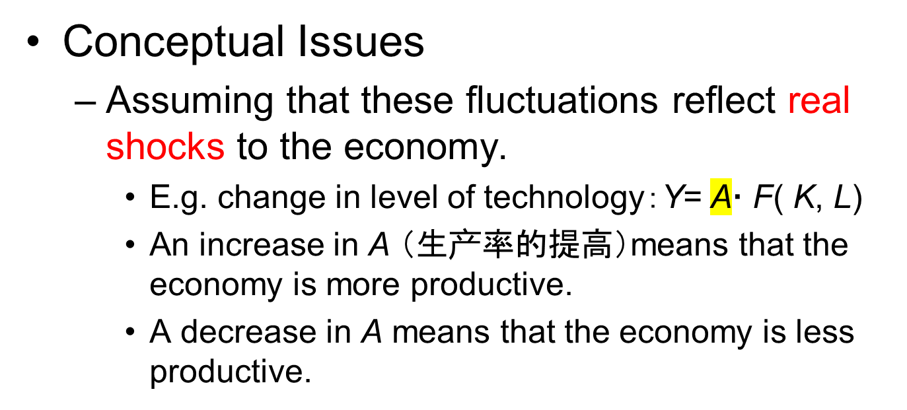
An Equilibrium
Business-Cycle Model

Slide 9
An Equilibrium
Business-Cycle Model
The Model
  Y= A· F( K, L)
    the capital stock, K, as fixed in the short run,
    the labor input, L, is fixed as well.
    Changes in Y will reflect only changes in A.
    When A rises, Y rises,
    When A falls, Y falls.

Slide 10
An Equilibrium
Business-Cycle Model
The Model
  The marginal product of labor and the real wage rate
    An increase in the technology level, A, raises the marginal product of labor, MPL, for given inputs of capital, K, and labor, L.

Slide 11
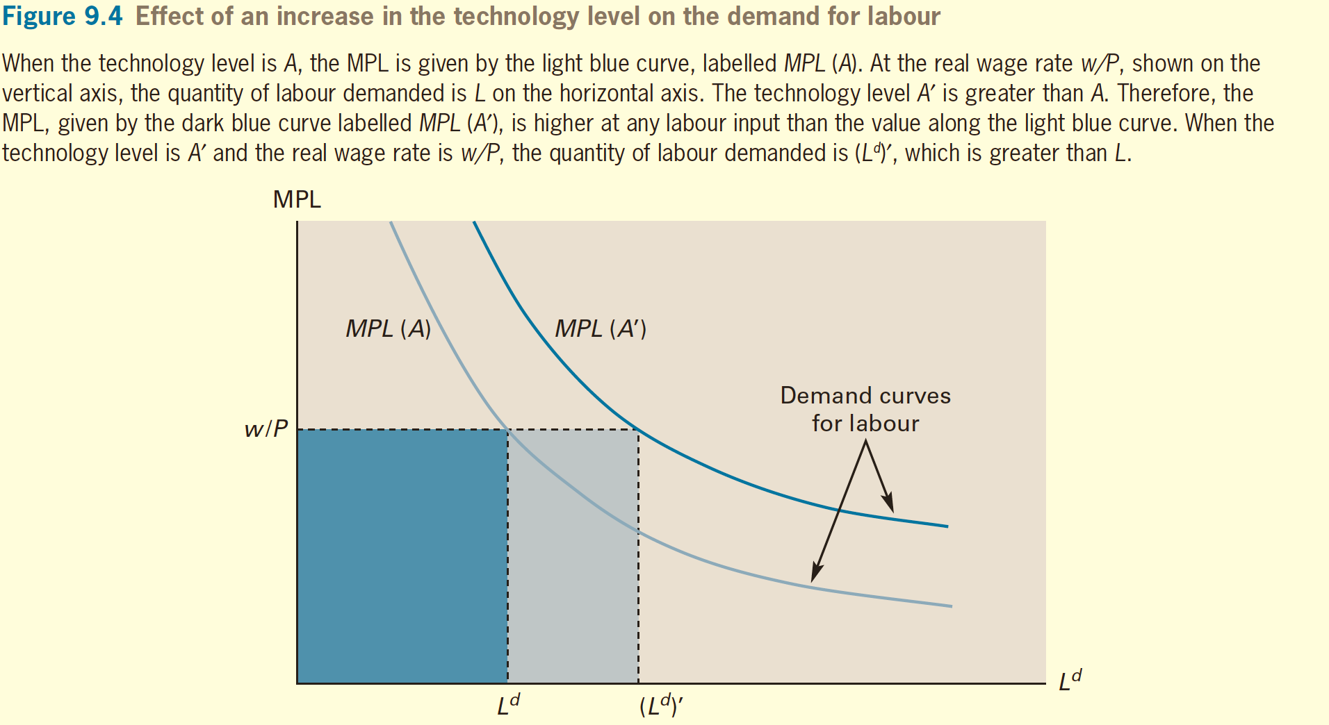
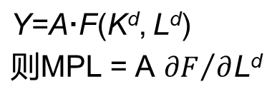
An Equilibrium
Business-Cycle Model

Slide 12
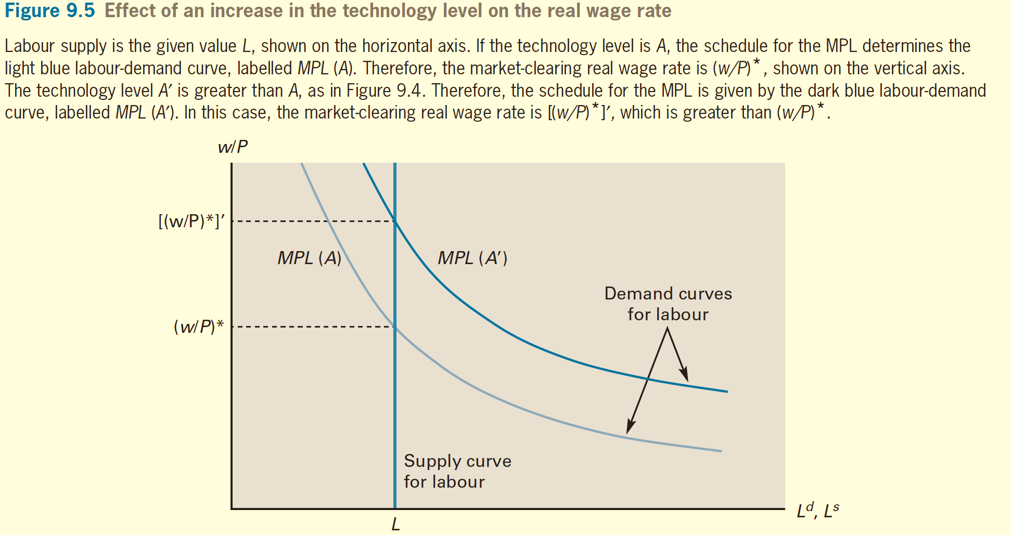
An Equilibrium
Business-Cycle Model

Slide 13
An Equilibrium
Business-Cycle Model
The Model
  Marginal product of capital, real rental price, and the interest rate
    An increase in the technology level, A, raises the marginal product of capital, MPK, for given inputs of capital, K, and labor, L

Slide 14
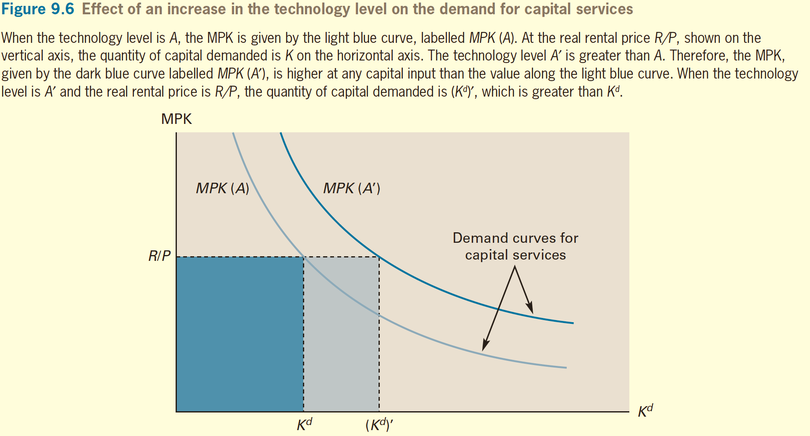
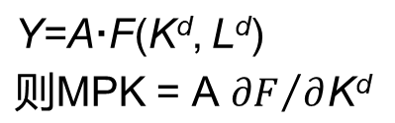
An Equilibrium
Business-Cycle Model

Slide 15
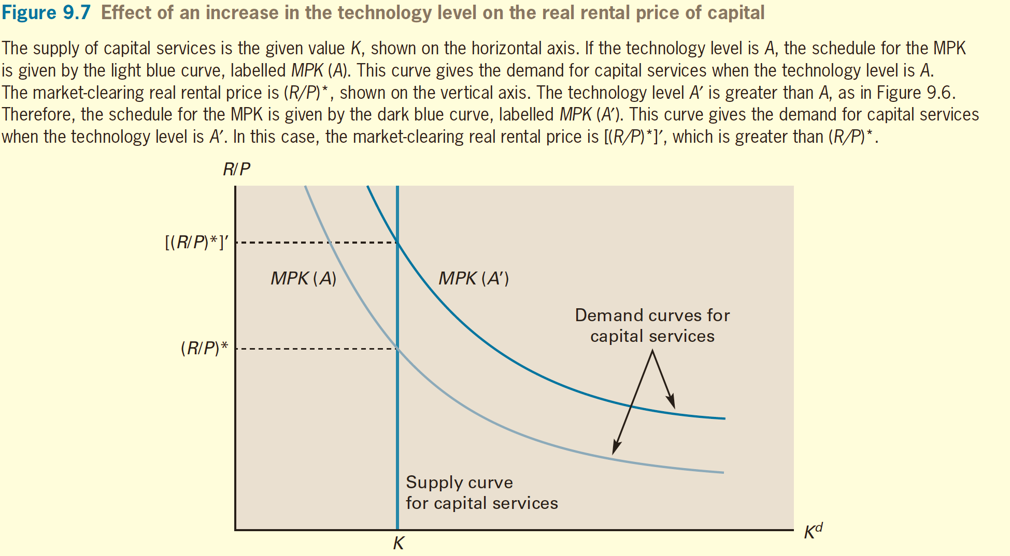
An Equilibrium
Business-Cycle Model

Slide 16
An Equilibrium
Business-Cycle Model
The Model
  Marginal product of capital, real rental price, and the interest rate
    i = R/P − δ
    i = MPK( evaluated at given K and L, in equilibirum) − δ
    An increase in the technology level, A, raises the marginal product of capital, MPK, at given inputs of capital, K, and labor, L, as well as the real rental rate, R/P.
    The model also predicts that an economic boom （solo determined by A）will have a relatively high interest rate,i, whereas a recession will have a relatively low interest rate.

Slide 17
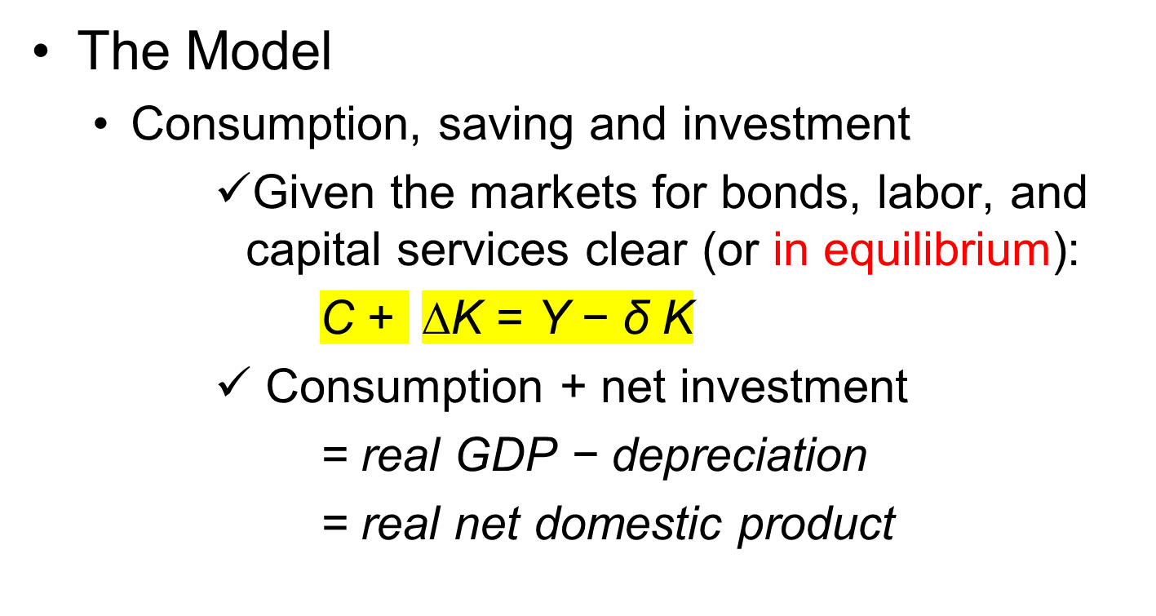
An Equilibrium
Business-Cycle Model

Slide 18
An Equilibrium
Business-Cycle Model
The Model
  Consumption, saving and investment
    C+ ∆K = A · F( K, L) − δ K
      depreciation, δK, is fixed in the short run
    An increase in A raises real GDP for given K and L, that is, rise in A raises overall real income.

Slide 19
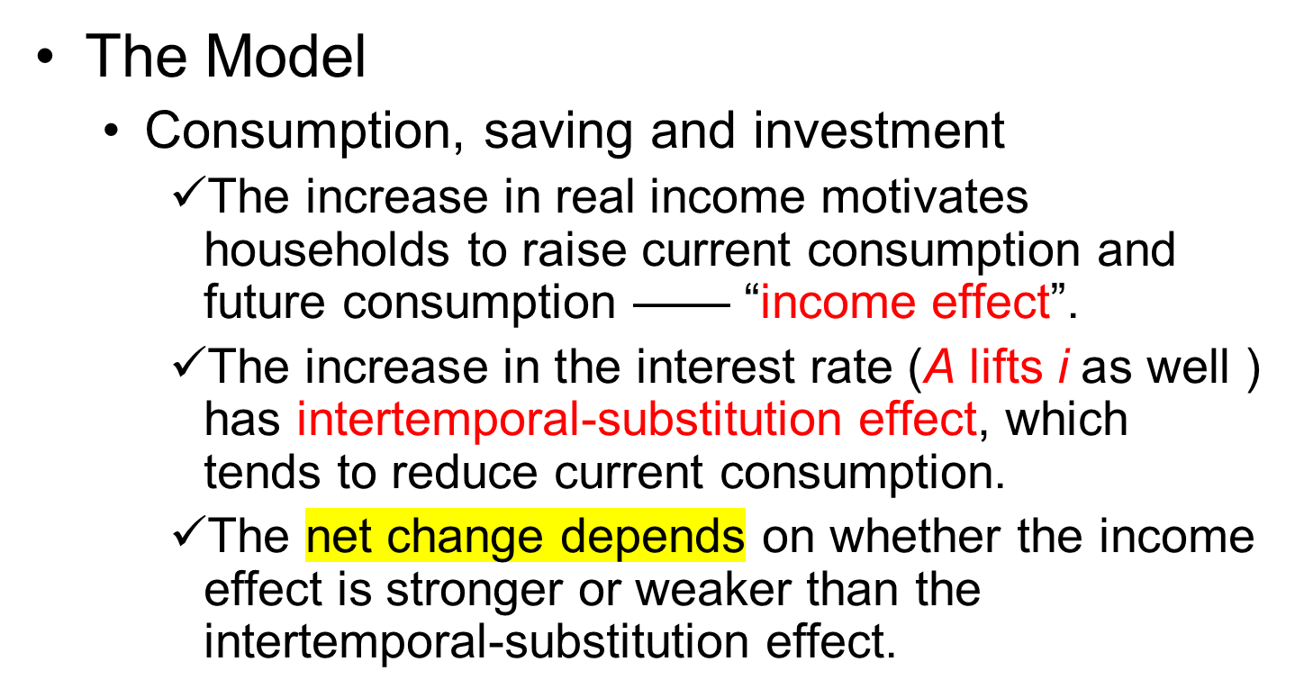
An Equilibrium
Business-Cycle Model

Slide 20
An Equilibrium
Business-Cycle Model
The Model
  Consumption, saving, and investment
    Assume that the change in A is permanent. (Thus, the increases in real income tend also to be permanent).
    The propensity to consume out of higher income would be close to one.
    Current consumption will rise.
    However, as long as the intertemporal-substitution operates at all, the increase in current consumption will be less than the increase in real GDP.

Slide 21
An Equilibrium
Business-Cycle Model
The Model
  Consumption, saving and investment
    Since current consumption, C, rises, but by less than the increase in real GDP, Y. net investment, ∆K, must increase.
    Increase in real GDP shows up partly as more C and partly as more K.
    Since net investment, ∆K, equals real saving (assume bonds market clears), this result is consistent with our finding that real saving increased.

Slide 22
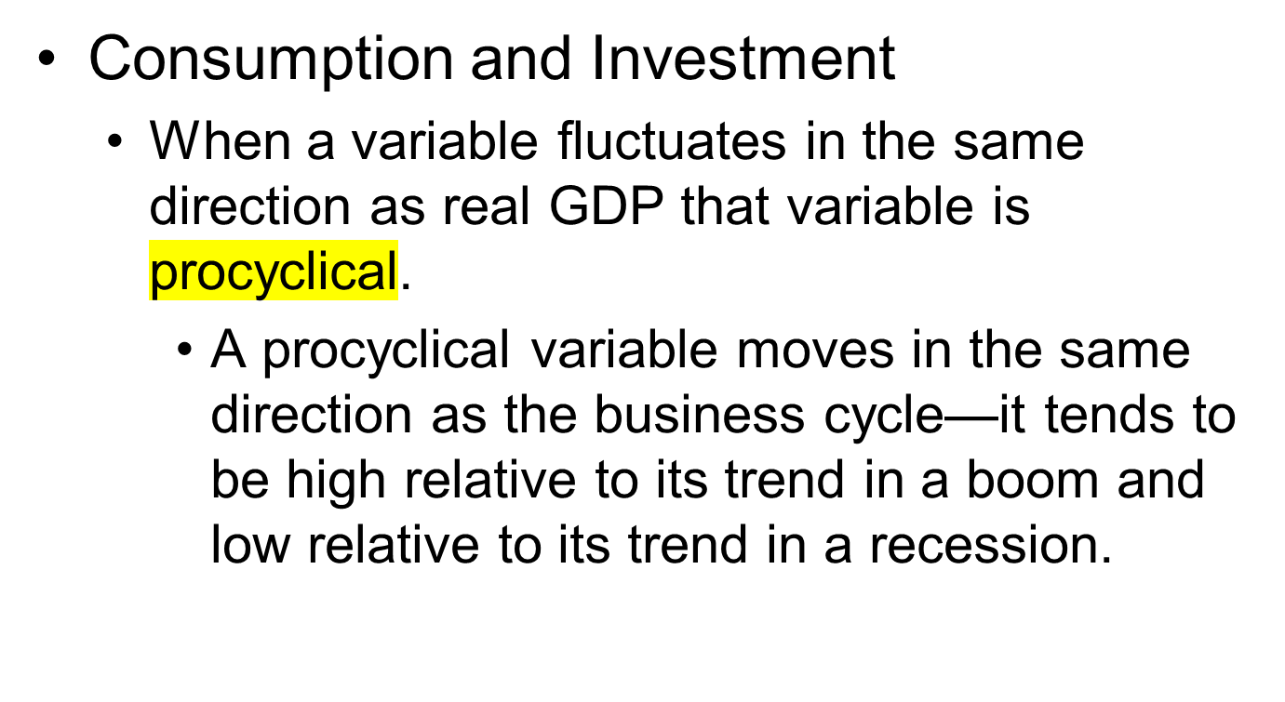
Matching the Theory with the Facts

Slide 23
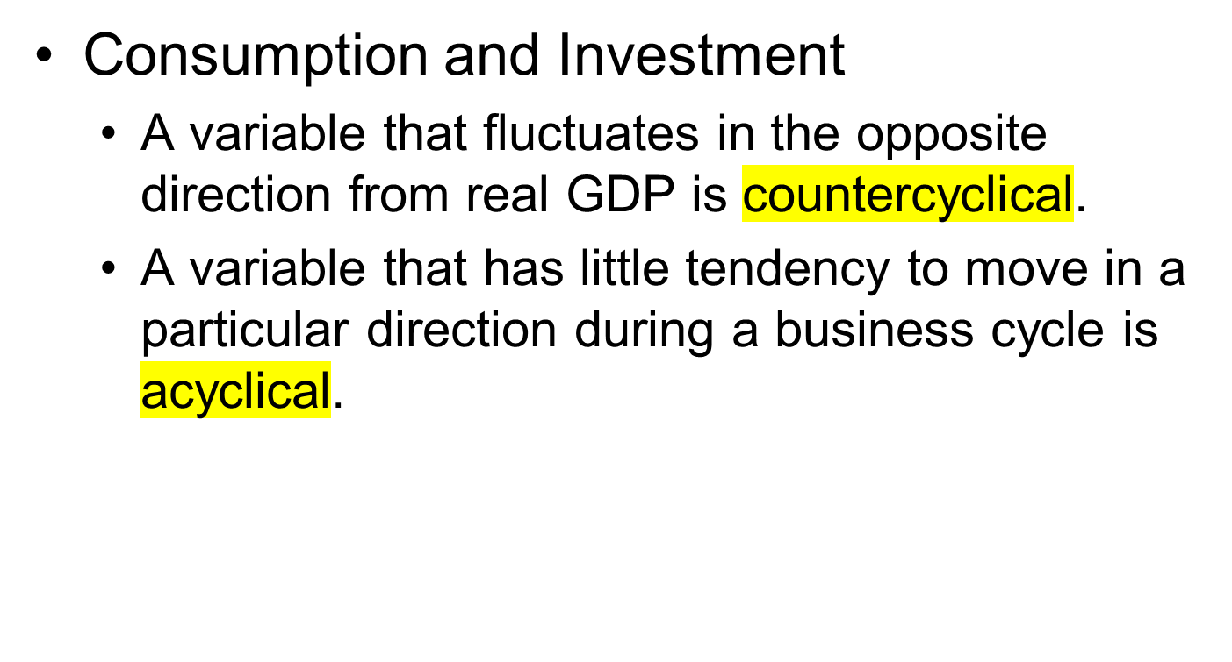
Matching the Theory with the Facts

Slide 24
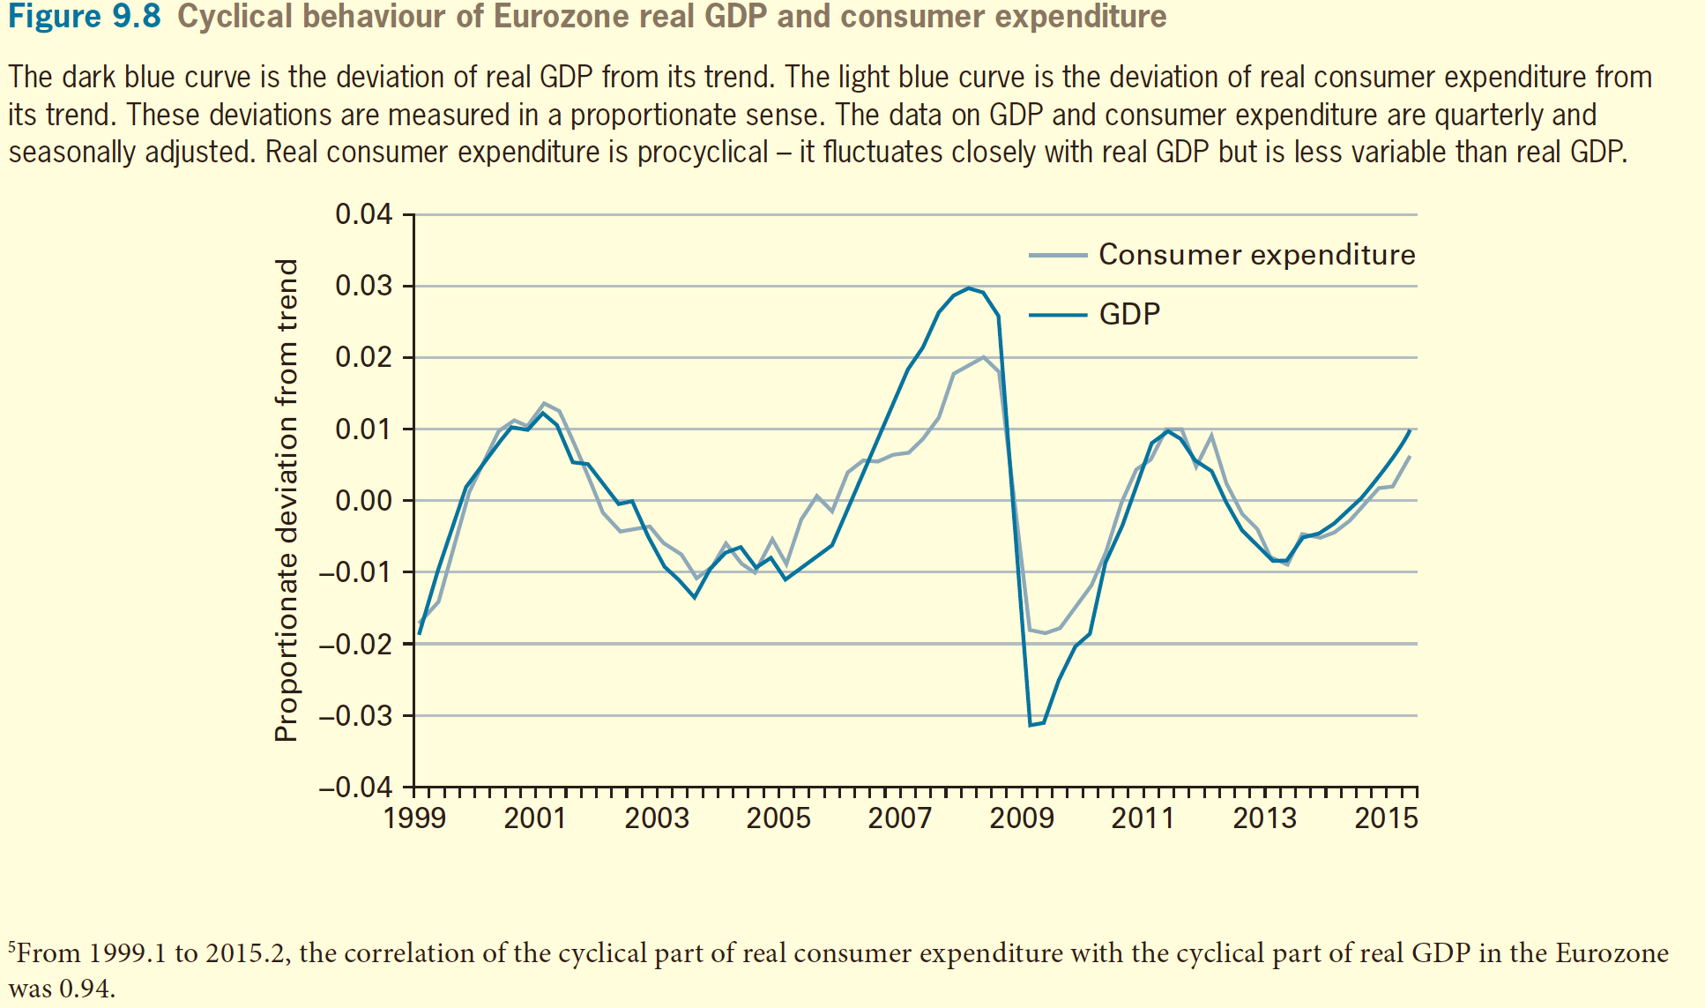
Matching the Theory with the Facts

Slide 25
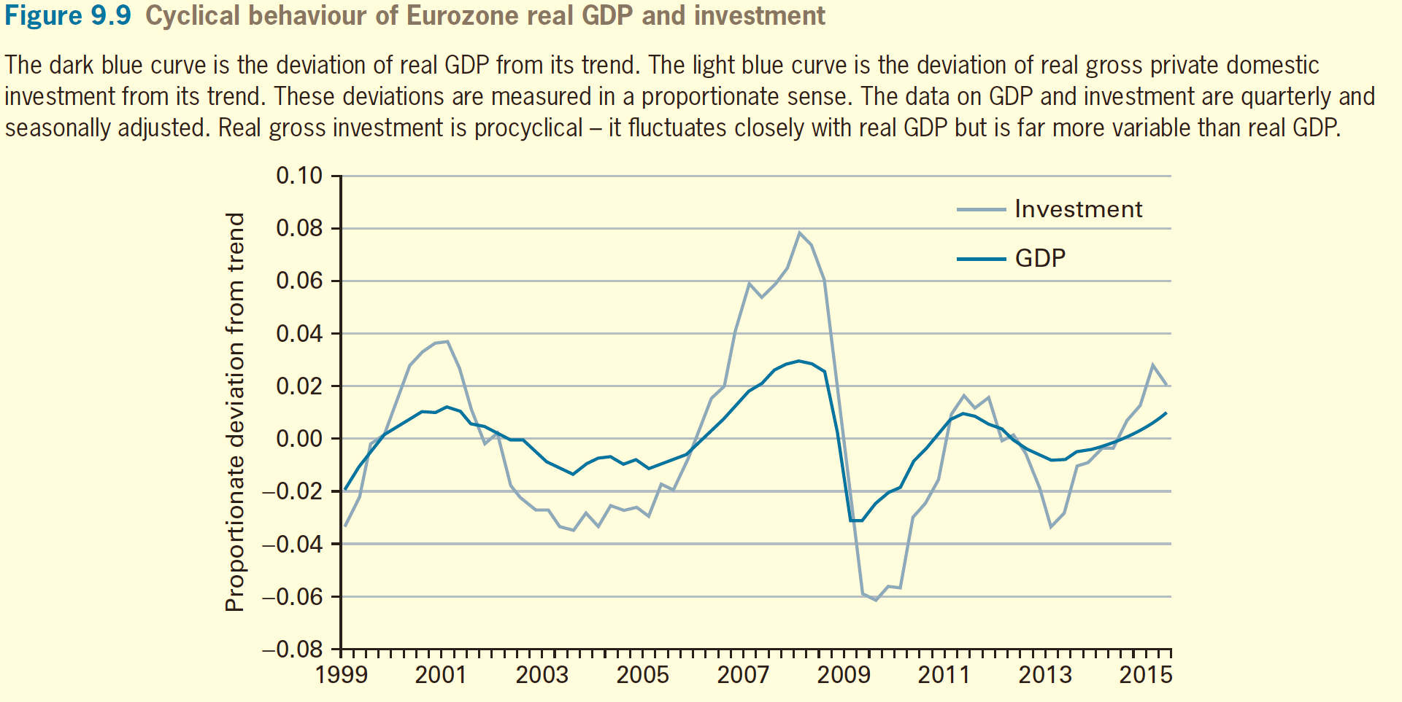
Matching the Theory with the Facts

Slide 26
Matching the Theory with the Facts
Consumption and Investment
  Permanent shifts in the technology level, A, match up with some of the empirical patterns
    Increases in A generate economic booms, where real GDP increases, consumption and investment increases.
    Decreases in A create recessions, where real GDP, consumption and investment all decline.

Slide 27
Matching the Theory with the Facts
The Real Wage Rate
  The model predicts that the real wage rate, w/P, will be relatively high in booms and relatively low in recessions.

Slide 28
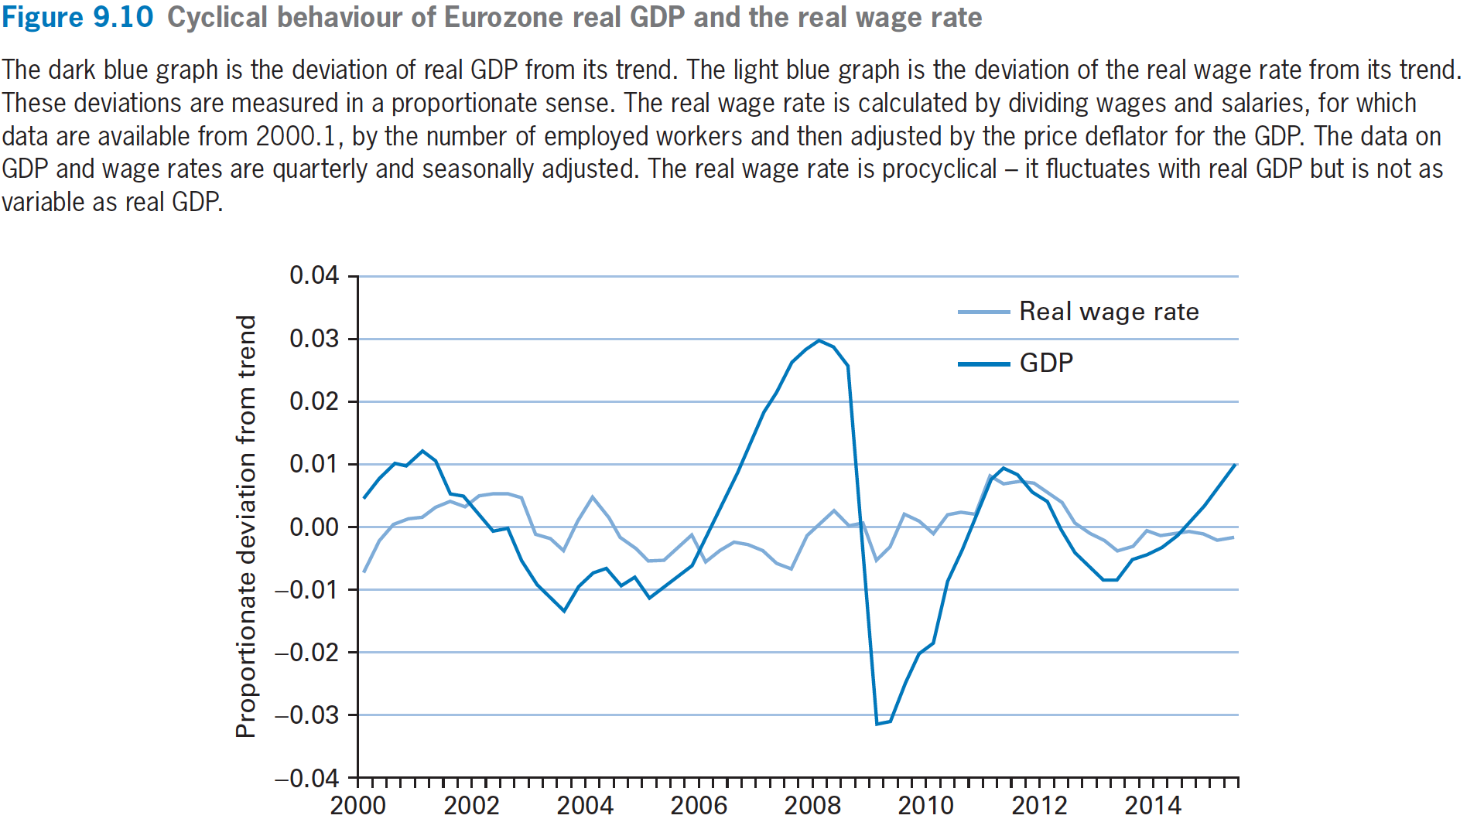
Matching the Theory with the Facts

Slide 29
Matching the Theory with the Facts
The Real Rental Price
  The model predicts that the real rental price of capital, R/P, will be relatively high in booms and relatively low in recessions.

Slide 30
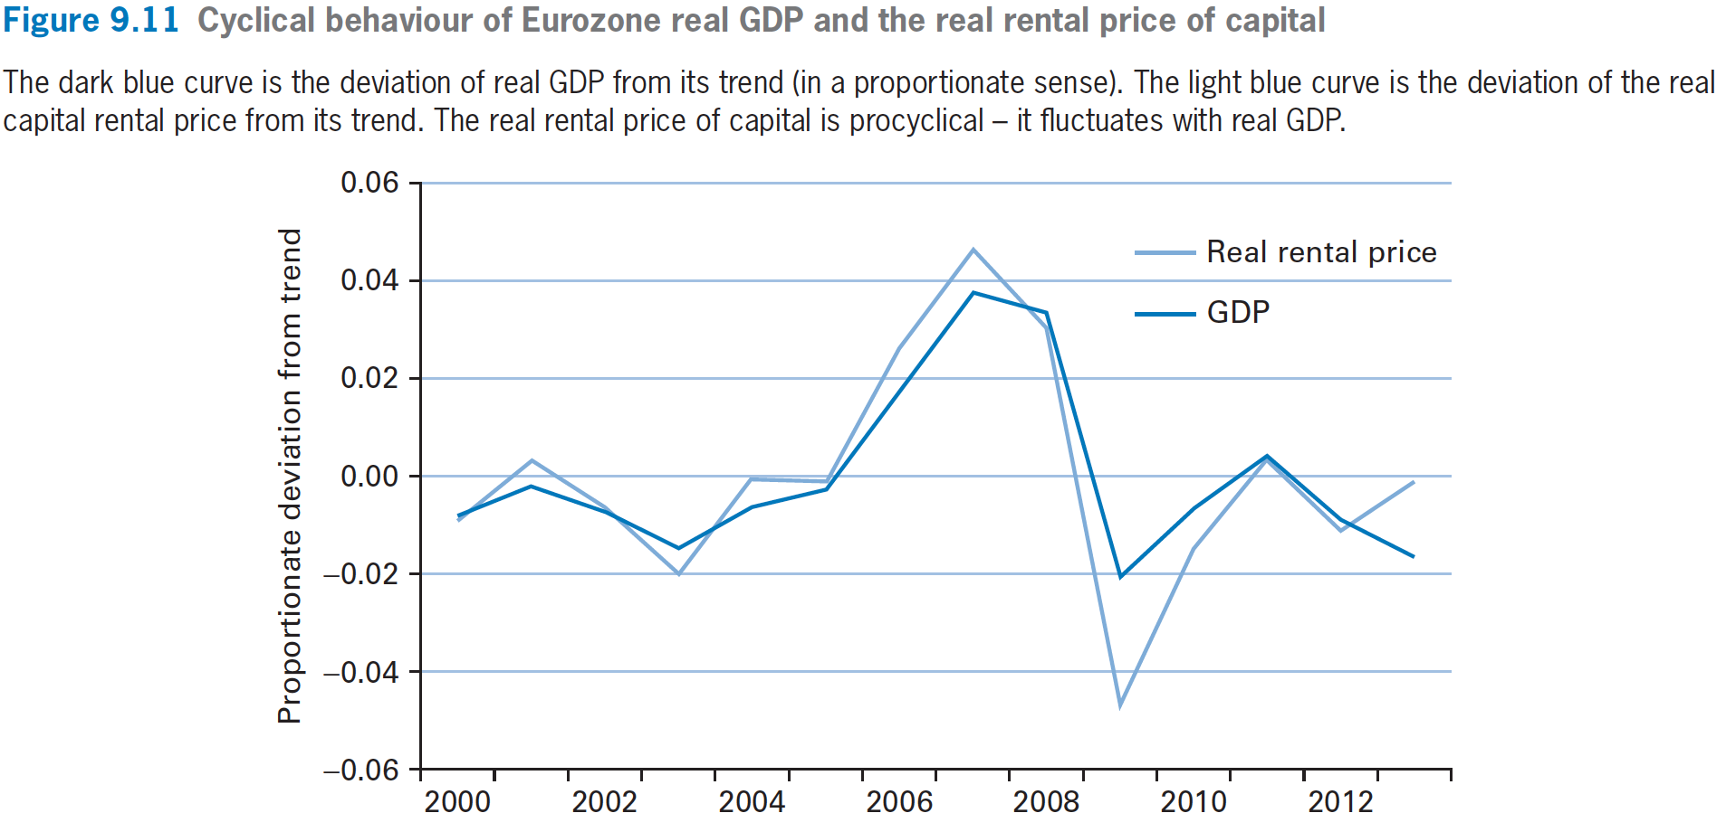
Matching the Theory with the Facts

Slide 31
Matching the Theory with the Facts
The Interest Rate
  The model predicts that booms will have a high interest rate, i, whereas recessions will have a low interest rate.
  Can you find facts ?(using China’s data)

Slide 32
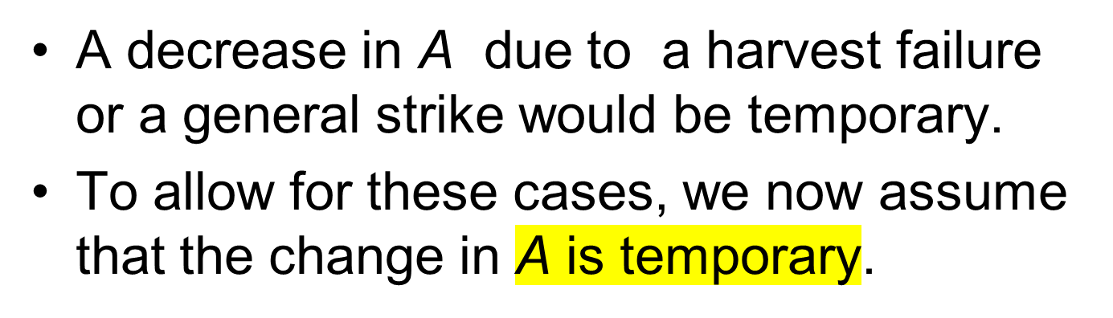
Temporary Changes in the Technology Level

Slide 33
Temporary Changes in the Technology Level
If A increases temporarily, real GDP (Y=A · F (K, L)), still rises for fixed values of K and L.
The marginal product of capital, MPK, and the interest rate, i, also rise as before.
The intertemporal-substitution effect from the higher i still motivates households to reduce current consumption, C, and raise current real saving.

Slide 34
Temporary Changes in the Technology Level
The model therefore predicts that economic boom would feature high real GDP and high investment.
  Since income effect would increase current consumption by a small amount.
vice verse, A recession would have low real GDP and low investment,
  Income effect would lower current consumption by a small amount.

Slide 35
Variations in Labor Input
Labor Supply
  More labor supplied means less leisure time for the family.
  Assume that households also like more leisure time.(两种消费品：闲暇和普通商品，都是正常品，收入增加，两种都增加，所谓的收入效应的定义）
  As with consumption and saving, the choice of L^{s} involves substitution effect and income effect.

Slide 36
Variations in labor Input
The substitution effect for leisure and consumption
  If the household chooses to work one more hour （and thereby have one less hour of leisure）, the extra w/P of real wage income pays for w/P more units of consumption.
  Therefore, the household can substitute one less hour of leisure for w/P more units of consumption.

Slide 37
Variations in Labor Input
  If real wage rate, w/P, rises, the household gets a better deal by working more because it gets more consumption for each extra hour worked.
  Since the deal is better, the household responds to a higher w/P by working more.
  A higher real wage rate, w/P, raises the quantity of labor supplied, L^{s}.

Slide 38
Variations in labor Input
Income effects on labor supply
  A higher w/P means higher real wage income, (w/P)· L^{s}
  Household spends the extra income on both consumption and leisure time.
  A higher w/P leads to more leisure time as well, that is, a smaller quantity of labor supplied, L^{s}.

Slide 39
Variations in labor Input
  Resolve the ambiguity by considering whether the income effect is strong or weak.
  A permanent increase in real wage rates results in a stronger income effect on labor input, thus more leisure is choosen.
  If the change in year₁’s real wage rate, (w/P)₁, is temporary, the income effect on labor input is small. In this case, the substitution effect on leisure time is stronger.

Slide 40
Variations in labor Input
Intertemporal-substitution effects on labor supply
  C₁ + C₂/(1+i₁) + C₃/[( 1+i₁)·(1+i₂) ] + · · ·
  = ( 1 + i₀)·(B₀/P+K₀) +
  (w/P)₁·L^{s}₁+(w/P)₂·L^{s}₂/(1+i₁) +
  (w/P)₃·L^{s}₃ /[(1+i1)·(1+i₂)] + · · ·

Slide 41
Variations in labor Input
  If A rises, leading the interest rate, i₁, to rise, a unit of year₂’s real wage income, (w/P)₂·L^{s}₂, becomes less valuable as a present value compared to a unit of year₁’s real wage income, (w/P)₁·L^{s} ₁.
  The household would thus increase L^{s}₁ and decrease L^{s}₂ as the interest rate, i₁, increases.

Slide 42
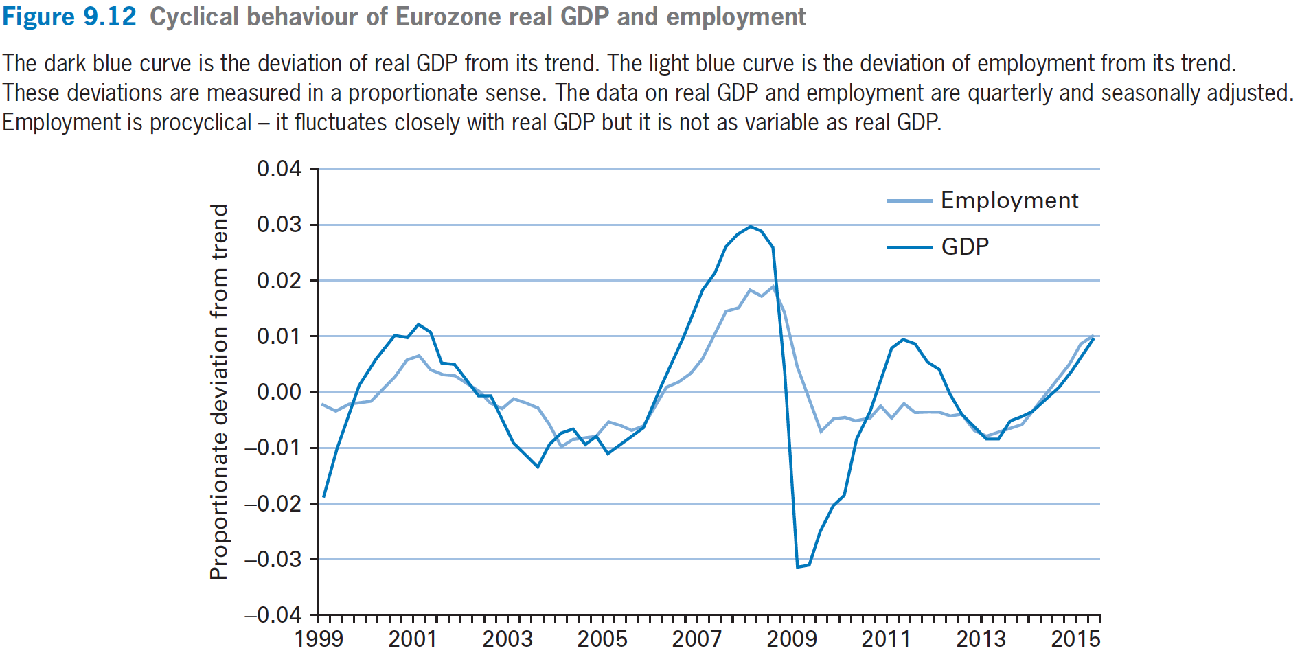
Variations in labor Input

Slide 43
Variations in labor Input
The cyclical behavior of labor input: theory
  Increase in A will lead to:
    The real wage rate increases
    labor inputs increase
Fluctuations in labor Input: facts
  Measures of labor input are pro-cyclical: they move in the same direction as real GDP during booms and recessions.
    Employment rate
    Total hours worked per worker

Slide 44
Variations in labor Input
The cyclical behavior of labor productivity
  Measures of labor productivity,
    Y/L, is real GDP per worker, or
    Real GDP per worker-hour
    labor productivity turns out to be procyclical in both measures.
    Can you find out data to support this?

